Slide 1

Medical Imaging Enterprise System
SEP 2024 – Project Proposal
Group 002

Slide 2

Introducing a Visionary Leap in Image Processing: VisionaryPixel Platform
Seamless Integration, Limitless Possibilities
Redefining Focus and Efficiency
The Future of Business Operations in Imaging
Our Commitment: "Empowering your Image Processing Systems, our proposed application is designed to handle the business nuances, enabling you to focus on delivering exceptional imaging results. Join us in this exciting journey towards a smarter, more efficient imaging future."

Slide 3

Motivation
Sector Growth
AI Revolution
Barrier to Entry
Management System Shortfall
Improving Healthcare Outcomes

Slide 4
Impact
Medical Imaging
Market Size
Massive Market Opportunity
Enabling Product Innovation
Accelerating Healthcare Advancements
Improving Patient Care
2022
2032
$72B
$45B

Slide 5

Imaging Product

Slide 6
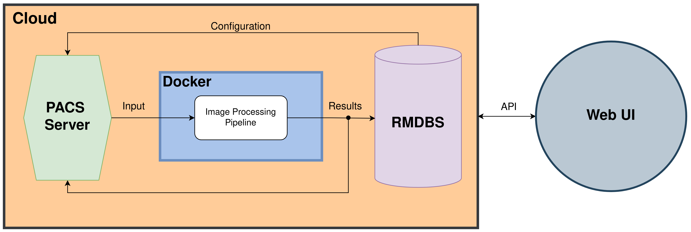
System Overview

Slide 7





Technical Aspects
Compute
Cloud
Scaling and Deployment
Resource Management
Portability
Infrastructure Management
Internal Monitoring
Accessibility
Scalability

Slide 8






Technical Aspects
Database
Web Interface
Client Managment
Automated Billing
Study Monitoring
Django (backend API)
Secure
DRY
PostgreSQL
React (UI)
SPAs

Slide 9

Security
User validation with 2-factor authentication
Firewalls protecting all internal components
No Patient Health Information(PHI) will be kept
Docker

Slide 10
Stakeholders
Hospitals
Independent Doctors/ Health Care providers
Insurance Companies
Imaging Companies

Slide 11




The Team
Audrey Powers
Masters of Computer Science
Zach Morris
Masters of
Computer Science
Ivan Johnson​
Masters of Electrical & Computer Engineering​
​
Michal Brzus
PhD Electrical & Computer Engineering

Slide 12

Book Report
Ivan – AWS
Zach - Docker
Audrey – GitHub Actions
Michal - Kubernetes

